Slide 1
Final Group Project PROG8485 | Mobile Application Development – Android
Giinie – Professional home services at one place.

Slide 2
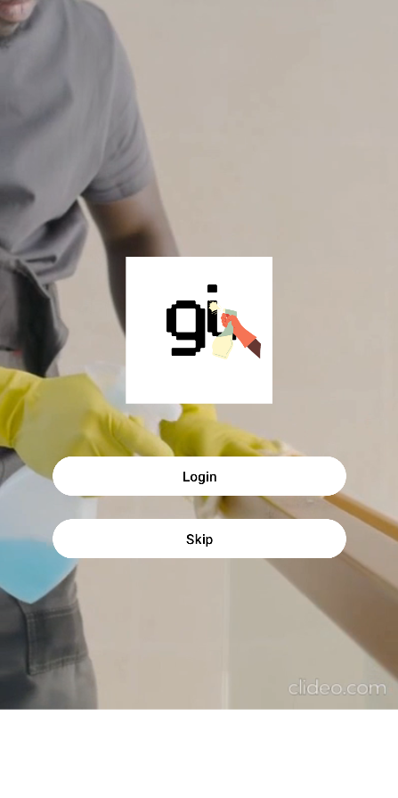
Group Members
Praveen Kumar Pugazhendi - 8868015
Nithish Jagadeesan - 8875048
Tarunkumar Rajendrabhai Mistry - 8865783

Slide 3
Application Description
With the help of this mobile app, Giinie, customers can quickly and easily complete jobs around the house by connecting with various home service providers. Giinie can assist you with any home-related service, including plumbing, cleaning, repairs, gardening, and more. Giinie guarantees that users can quickly identify and employ reputable professionals for their unique needs.

Slide 4
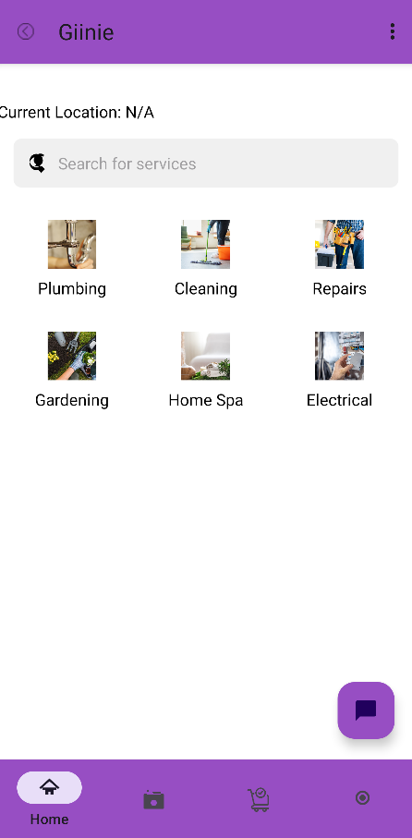
Key Features
1. Service Listings
Giinie offers various services such as plumbing, cleaning, repairs, gardening, and more.

Slide 5
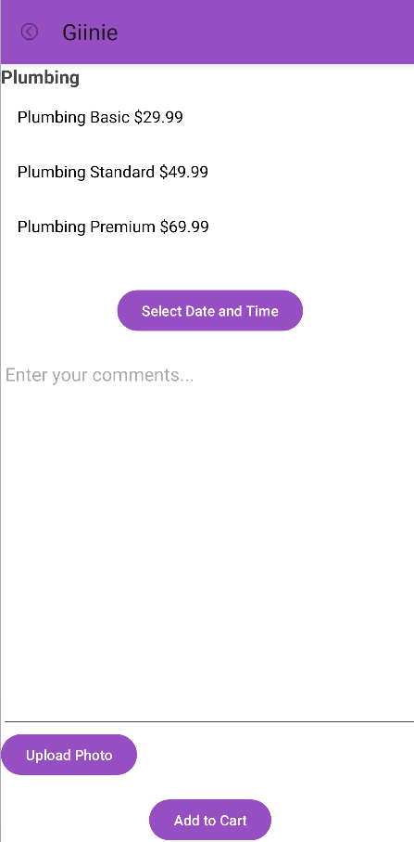
Key Features
2. Scheduling and booking
Users can check the schedule and book their service providers accordingly.

Slide 6
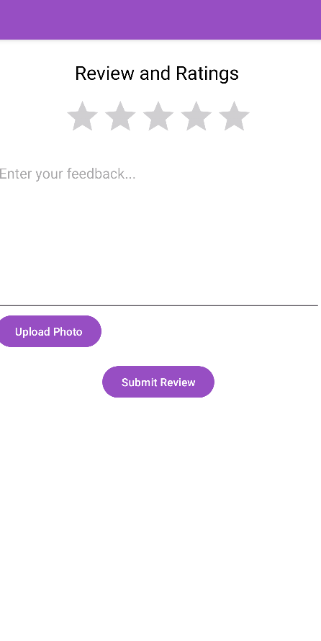
Key Features
3. Service ratings and reviews
Reviews and ratings for each service can be provided by the user and viewed by both user and service providers.

Slide 7
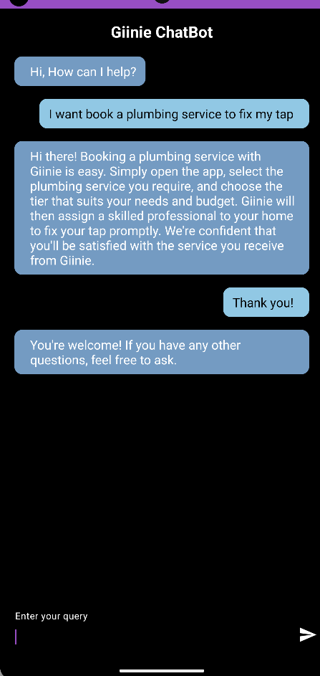
Key Features
4. AI chatbot customer service
Customers can interact with the intelligent AI chatbot for guidance or assistance.

Slide 8
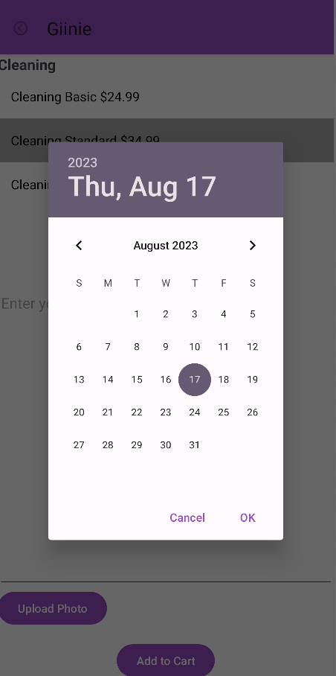
Key Features
5. User-friendly interface
An excellent user-friendly interface can provide a good user experience.

Slide 9
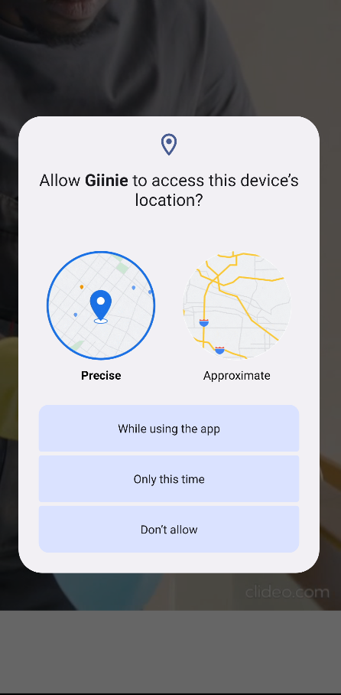
Advanced Features
AI chatbot – a chatbot for customer service.
Camera – camera access is required so users can post their problems to the service providers.
Microphone – microphone access is required to use the voice recognition feature.
Geolocation – geolocation access is required to help the service providers reach the customer’s place.
Map – map can help users find nearby service providers based on location.

Slide 10
Thank You!

